Slide 1
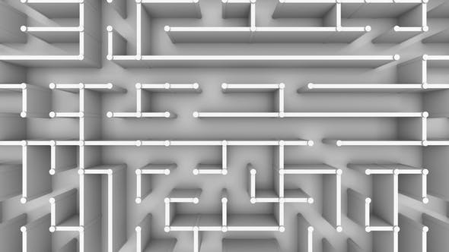
The Dark Maze
Taha Ahmed, Sebastian Stecher, Tobias Bressler,
Vincenz Wimmer, Vratislav Doronenko

Slide 2
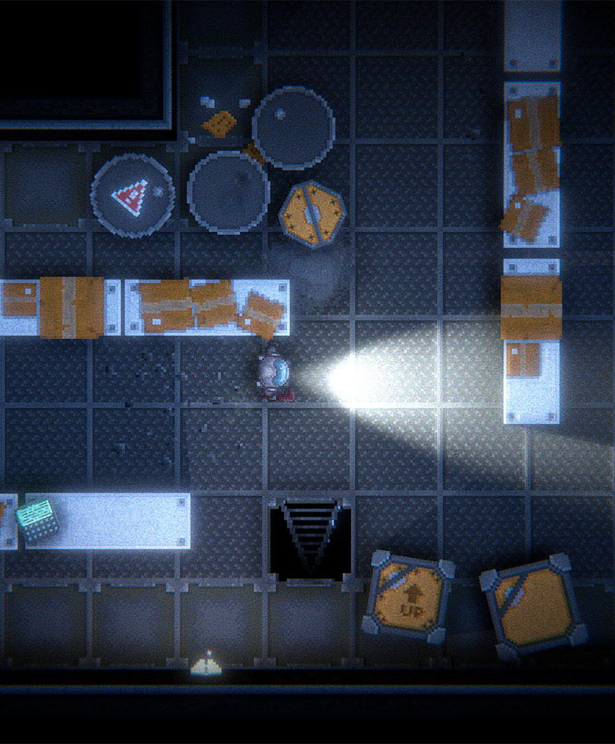
Concept
Unity Engine
2D Top-Down View
Limited Vision through flashlight
Story
Different Missions/Levels
Perks/Upgrades/Shops
Player Choice
Notes:
RPG
2D Top Down Perspektive
Begrenzte Sicht mit Taschenlampe
Missionen:
Z.B Dorfbewohner fragen
Perks/Upgrades: Increase Brightness/Increase Flashlight
Story: Abduction/HorrorTheme-ish
Map: Choices, Tough, Easy
View: Map, Zoom-In,
Shop: Increase Flashlight
Depiction: Pixelart

Slide 3
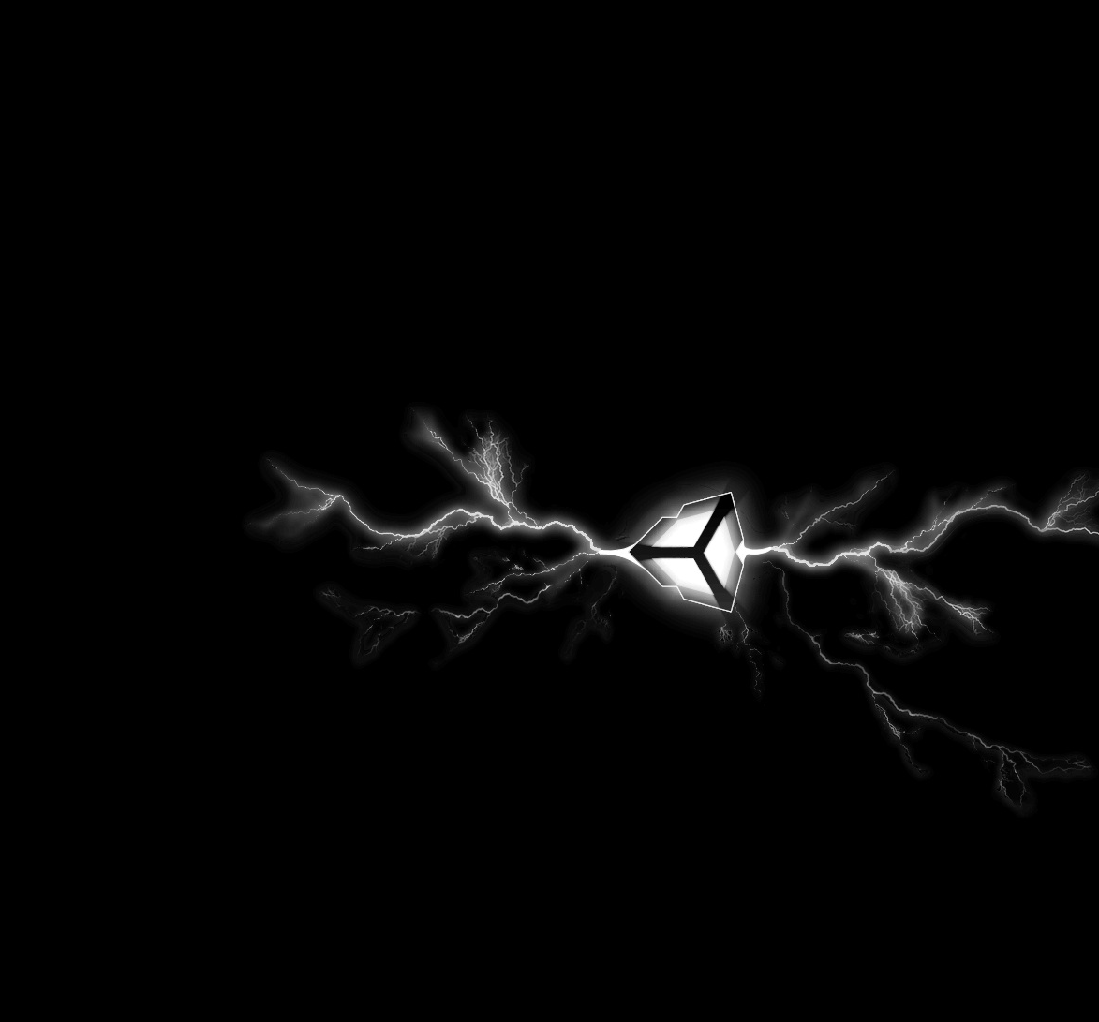
Thank you for your attention

